Slide 1


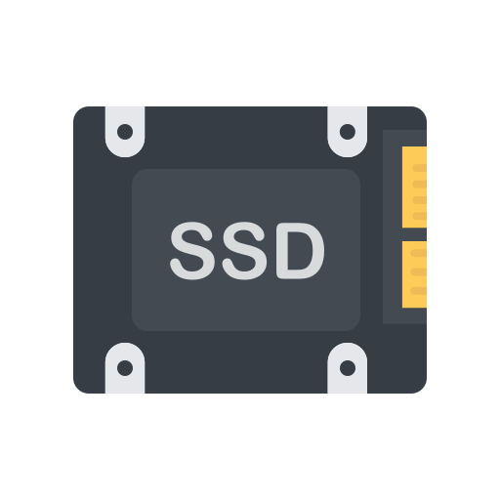

RAM
CPU
STORAGE
OS Kernel
runtime
runtime
runtime
runtime
App 1
App 2
App 3
App 4

Slide 2

CORE 1
CORE 2
CORE 5
CORE 6
HYPER-THREADING: ON
CORE 3
CORE 4
CORE 7
CORE 8
CPU
8 PHYSICAL CORES
16 LOGICAL/HYPER-THREADED CORES

Slide 3
sysctl hw.logicalcpu
sysctl hw.physicalcpu
sysctl hw.ncpu
sysctl -a | grep machdepcpu | grep count

Slide 4
PHYSICAL CORE
OS Kernel
THREAD 1
THREAD 2
THREAD 3
THREAD 4
THREAD 5
THREAD 6
task 1
task 1
task 1
task 1
task 1
task 1
task 2
task 2
task 2
task 2
task 2
task 2
task 3
task 3
task 3
task 3
task 3
task 3
task 4
task 4
task 4
task 4
task 4
task 4

Slide 5

Operating System
OS Kernel
User Level Threads
Kernel Level Threads
steevehook

Slide 6

THREAD
LOGICAL CORE
task 1
1s
task 3
task 2
0.2s
task 4
task 3
0s
task 2
task 4
0.1s
task 1

Slide 7

Concurrency is DEALING with a lot of things
at the same time. Parallelism is DOING
a lot of things at the same time.

Slide 8
task 1
5ms
task 1
1s
task 2
task 2
0.2s
task 3
task 3
0s
task 4
task 4
0.1s

Slide 9
CORE 1
CORE 2
task 1
task 1
task 5
5ms
1s
5ms
task 5
0.5s
task 2
task 2
task 6
0.2s
task 6
0.3s
task 3
task 7
task 3
0s
task 7
0.1s
task 4
task 4
task 8
0.1s
task 8
0.2s

Slide 10



OS Kernel
Go Scheduler
Go App (Runtime)
Main G
task 1 go routine
task 2 go routine
task 3 go routine
task 4 go routine
task 5 go routine
task 1
task 4
task 7
task 6 go routine
task 7 go routine
task 2
task 5
task 8
task 8 go routine
task 3
task 6
task 9
task 9 go routine

Slide 11


main
fork
child
join
main
child

Slide 12
race conditions
deadlocks
livelocks
starvation
code complexity

